Slide 1
Machine Learning
CSE 4020
Dr. Abdul Quadir Md

Slide 2
Week 1

Slide 3

Machine Learning - An Introduction
Was coined by Arthur Samuel in 1959, an American pioneer
“It gives computers the ability to learn without being explicitly programmed”.
And in 1997, Tom Mitchell gave a “well-posed” mathematical and relational definition that

Slide 4

Machine Learning - An Introduction
A computer program is said to learn from:
experience E with respect to some task T
and
some performance measure P,
if its performance on T, as measured by P,
improves
with experience E

Slide 5
Artificial Intelligence
The word Artificial Intelligence comprises of two words “Artificial” and “Intelligence”.
Artificial refers to something which is made by human or non natural thing
Intelligence means ability to understand or think.
There is a misconception that Artificial Intelligence is a system, but it is not a system .
AI is implemented in the system.
There can be so many definition of AI, one definition can be “It is the study of how to train the computers so that computers can do things which at present human can do better.”
Therefore It is a intelligence where we want to add all the capabilities to machine that human contain.

Slide 6
Best Python libraries for Machine Learning
Numpy
Scipy
Scikit-learn
Theano
TensorFlow
Keras
PyTorch
Pandas
Matplotlib

Slide 7
Numpy
NumPy is a very popular python library for large multi-dimensional array and matrix processing, with the help of a large collection of high-level mathematical functions.
It is very useful for fundamental scientific computations in Machine Learning.
It is particularly useful for linear algebra, Fourier transform, and random number capabilities.
High-end libraries like TensorFlow uses NumPy internally for manipulation of Tensors.

Slide 8
Numpy
Array in Numpy is a table of elements (usually numbers), all of the same type, indexed by a tuple of positive integers.
In Numpy, number of dimensions of the array is called rank of the array.A tuple of integers giving the size of the array along each dimension is known as shape of the array.
An array class in Numpy is called as ndarray.
Elements in Numpy arrays are accessed by using square brackets and can be initialized by using nested Python Lists.

Slide 9
SciPy
SciPy is built in top of the NumPy
SciPy module in Python is a fully-featured version of Linear Algebra while Numpy contains only a few features.
Most new Data Science features are available in Scipy rather than Numpy
SciPy in Python is an open-source library used for solving mathematical, scientific, engineering, and technical problems.
It allows users to manipulate the data and visualize the data using a wide range of high-level Python commands.
SciPy is built on the Python NumPy extention.
SciPy is also pronounced as "Sigh Pi."

Slide 10
Scikit
Scikit-learn is one of the most popular ML libraries for classical ML algorithms.
It is built on top of two basic Python libraries, viz., NumPy and SciPy.
Scikit-learn supports most of the supervised and unsupervised learning algorithms.
Scikit-learn can also be used for data-mining and data-analysis, which makes it a great tool who is starting out with ML.

Slide 11
Theano
Theano is a popular python library that is used to define, evaluate and optimize mathematical expressions involving multi-dimensional arrays in an efficient manner.
It is achieved by optimizing the utilization of CPU and GPU. It is extensively used for unit-testing and self-verification to detect and diagnose different types of errors.
Theano is a very powerful library that has been used in large-scale computationally intensive scientific projects for a long time but is simple and approachable enough to be used by individuals for their own projects.

Slide 12
TensorFlow
TensorFlow is a Python library for fast numerical computing created and released by Google.
TensorFlow is a very popular open-source library for high performance numerical computation developed by the Google Brain team in Google.
As the name suggests, Tensorflow is a framework that involves defining and running computations involving tensors. It can train and run deep neural networks that can be used to develop several AI applications.
TensorFlow is widely used in the field of deep learning research and application.

Slide 13
Keras
Keras is a very popular Machine Learning library for Python.
It is a high-level neural networks API capable of running on top of TensorFlow, CNTK, or Theano.
It can run seamlessly on both CPU and GPU. Keras makes it really for ML beginners to build and design a Neural Network.
One of the best thing about Keras is that it allows for easy and fast prototyping.

Slide 14
Pandas
Pandas is a popular Python library for data analysis.
It is not directly related to Machine Learning.
When dataset must be prepared before training.
In this case, Pandas comes handy as it was developed specifically for data extraction and preparation.
It provides high-level data structures and wide variety tools for data analysis.
It provides many inbuilt methods for groping, combining and filtering data.

Slide 15
Introduction To Anaconda
Anaconda is an open-source distribution for python and R.
It is used for data science, machine learning, deep learning, etc.
With the availability of more than 300 libraries for data science, it becomes fairly optimal for any programmer to work on anaconda for data science.
Anaconda helps in simplified package management and deployment.
Anaconda comes with a wide variety of tools to easily collect data from various sources using various machine learning and AI algorithms.
It helps in getting an easily manageable environment setup which can deploy any project with the click of a single button.
Now that we know what anaconda is, let’s try to understand how we can install anaconda and set up an environment to work on our systems.

Slide 16
Week 2

Slide 17
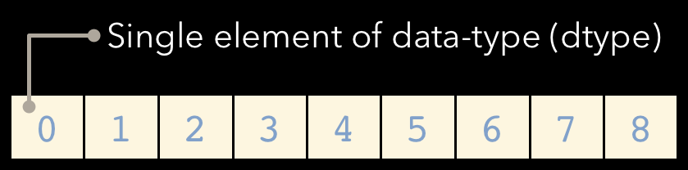
NUMPY
NumPy is a Python C extension library for array-oriented computing Efficient
In-memory
Contiguous (or Strided)
Homogeneous (but types can be algebraic)
NumPy is a Python C extension library for array-oriented computing Efficient
In-memory
Contiguous (or Strided)
Homogeneous (but types can be algebraic)
NumPy is suited to many applications Image processing
Signal processing Linear algebra
A plethora of others

Slide 18
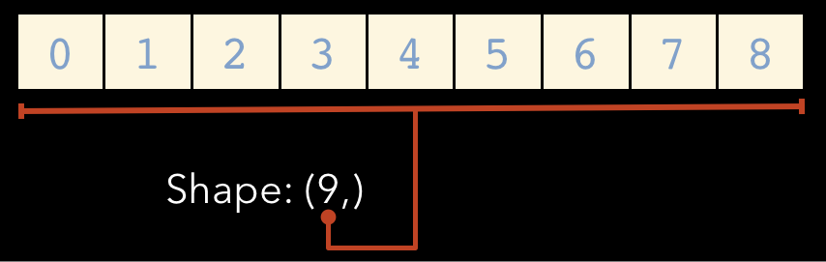
Array Shape
One dimensional arrays have a 1-tuple for their shape

Slide 19
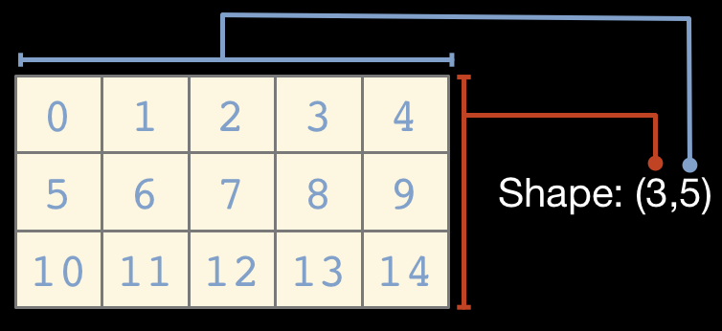
...Two dimensional arrays have a 2-tuple

Slide 20
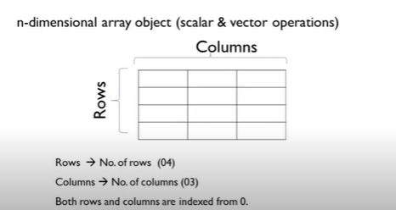
Numpy
Data being collected is in the form of rows and column
Column – attribute- characteristic of a particular domain eg: patient : age, sex, dob ,etc
Rows- data collected from different entities eg: patients data
We may want a package to compute the elements on the matrix like mean , median , SD, transpose/inverse of a matrix etc,

Slide 21
NUMPY - Methods commonly used
array – creating arrays - 1d-[] , 2d [[1,4], [2,3]]
Zero – init array with 0’s
ones - init array with 1’s
Shape – finding shape of array - rows and columns are there
ndim – to find the number of dimensions
size – to find the no of elements in an array
dtype – to find datatype of array
Itemsize - to find the size of one element

Slide 22
NUMPY - Methods commonly used
nbytes – finding total no of bytes
fill – to fill all elements with a value
arange – to create seq of no within a range with fixed step [1, 13, 2]
1- start, 10 – stop , interval of 2 --- o/p{1, 3, 5, 7,9,11}
linepace - to create list of nos within a range with var step
[1,11,15] - interval will be created by python itself automatically
eye - identity matrix – diagnaol matrix -1
random – creating different set of operations using random no

Slide 23
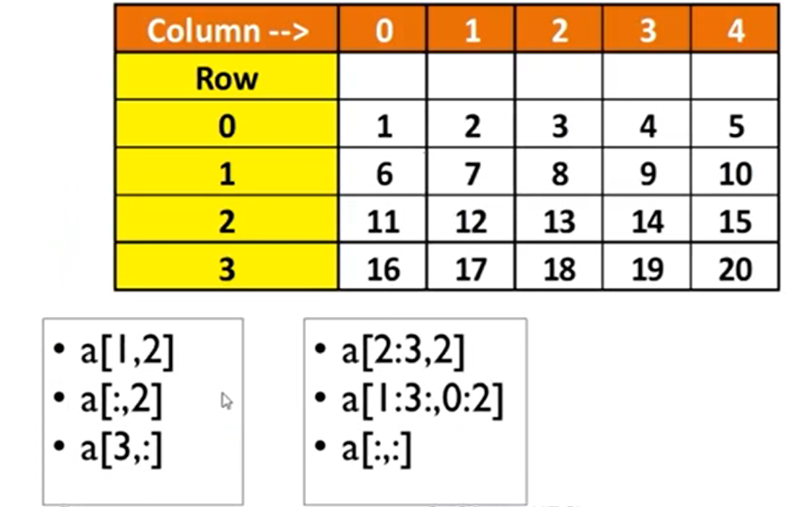
NUMPY - SLICING
8
3,8,13,18
16,17,18,19
FURTHER PART
[2-2, 2] - 13
FURTHER PART
[1,2 ] [0,1] ====[6 7]
[11 12]

Slide 24
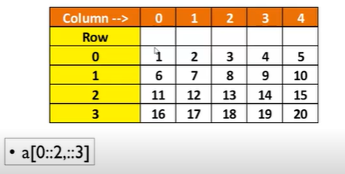
NUMPY - Striding
Rows
0- start value is 0
Stop value is not specified
Interval of 2
========
Column
Interval of 3
===========
[1 4]
[11 14]

Slide 25
Masking
arr11 = np.array([1,2,3,4,5,6,7,8,9])
mask = np.array([0,1,1,0,1,0,1,0,0],dtype=bool)
print(arr11[mask])

Slide 26
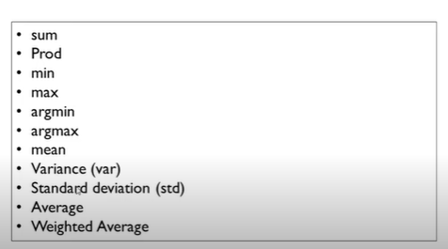
Methods

Slide 27
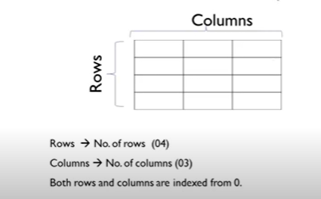
Pandas - Dataframe
Any dataset ends up with 2d matrix
We can bring any dimen to 2d matrix
map 2d to rel DB
Every row we add refers to a tuple

Slide 28
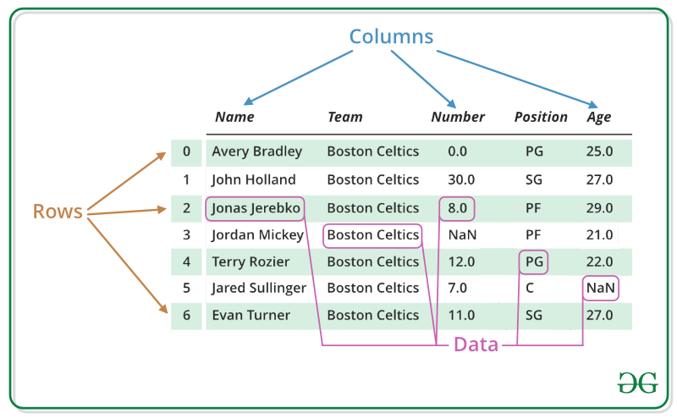
Pandas - Dataframe
A Data frame is a two-dimensional data structure, i.e., data is aligned in a tabular fashion in rows and columns.
Pandas DataFrame consists of three principal components, the data, rows, and columns.

Slide 29
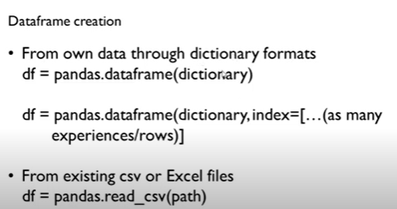
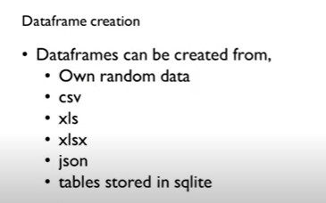
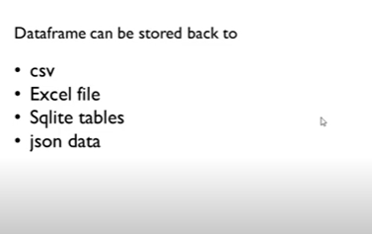
Pandas - Dataframe
Key : unique entity
Corresponding values to the key
Any method can be accessed using dot operator
Index correspondes to entity a ,b,c

Slide 30
Pandas - Dataframe
info –to get complete description of the data
shape- how many no of rows and coloumns
head – to read first few records (default - 5)
tail - to read last few records (default - 5)
drop_duplicate – removing duplicates in row (llr coloumns across the row)
inplace =true (operation has to be performed on the dataframe and stored back in the dataframe itself)
keep(first/last/false) (if you have 3 rows with same entity)

Slide 31
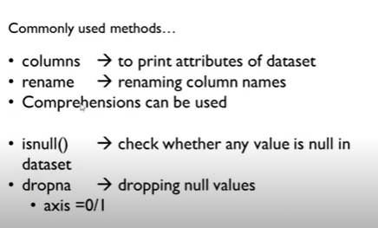
Pandas - Dataframe

Slide 32
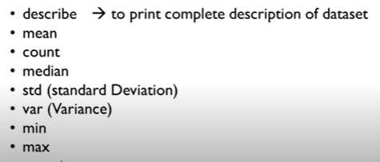
Pandas - Dataframe

Slide 33
Pandas - Slicing
loc - by name
iloc – by index

Slide 34
Week 3

Slide 35
Pyplot
matplotlib.pyplot is a collection of functions that make matplotlib work like MATLAB.
Each pyplot function makes some change to a figure: e.g., creates a figure, creates a plotting area in a figure, plots some lines in a plotting area, decorates the plot with labels, etc.

Slide 36
Types
Line Plot
Scatter
Pie
Bar Charts
Twin Axes
Histograms
Subplots
3D Plots

Slide 37
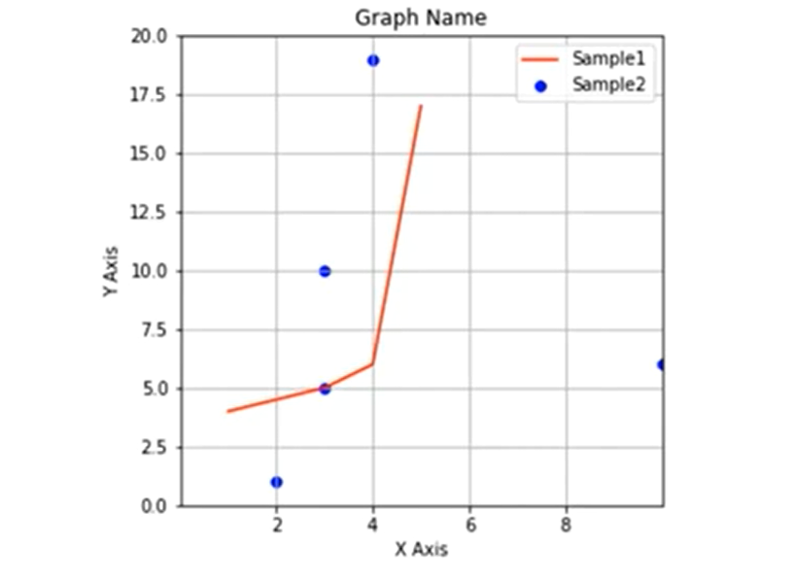
Basic 2D Graph Structure

Slide 38
Pyplot General
Xlabel, Ylabel
Xticks, Yticks
Legend
Title
Xlim, Ylim
Figure -> size
Savefig
Show

Slide 39
Seaborn
It is an amazing visualization library for statistical graphics plotting in Python.
It provides beautiful default styles and color palettes to make statistical plots more attractive.
It is built on the top of matplotlib library and also closely integrated to the data structures from pandas.
Seaborn aims to make visualization the central part of exploring and understanding data

Slide 40
Different categories of plot in Seaborn
Plots are basically used for visualizing the relationship between variables.
Those variables can be either be completely numerical or a category like a group, class or division.
Seaborn divides plot into the below categories
Relational plots: This plot is used to understand the relation between two variables.
Categorical plots: This plot deals with categorical variables and how they can be visualized.
Distribution plots: This plot is used for examining univariate and bivariate distributions
Univariate distribution: These are the distributions in which there is only one variable such as the heights of the students of a class.
Bivariate distribution: Distribution involving two discrete variable is called a bivariate distribution. For example, the heights and the weights of the students of a class in a school.

Slide 41
Different categories of plot in Seaborn
Regression plots: The regression plots in seaborn are primarily intended to add a visual guide that helps to emphasize patterns in a dataset during exploratory data analyses.
Matrix plots: A matrix plot is an array of scatterplots.
Multi-plot grids: It is an useful approach is to draw multiple instances of the same plot on different subsets of the dataset.

Slide 42
Week 4

Slide 43
Introduction to Supervised Learning

Slide 44
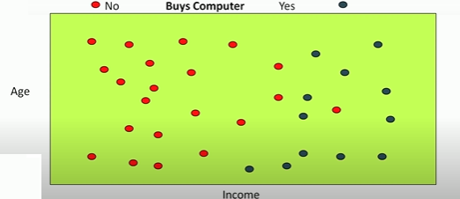
Supervised Learning- Classification
I have a customer database with two attributes age and income.
So I have each customer that comes to my shop.
I know the age of the customer and the income level of the customers .
Labeled data is for building a classifier:
Where the output is a discrete value in this case it is yes or no,
yes this is the person will buy a computer
No the person will not buy a computer.

Slide 45
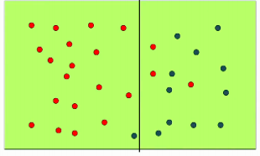
Possible Classifier
Goal is to come up with a function , that will take the age and income as the input and it will give you an output.
The person will buy the computer or not buy the computer
So there are many different ways in which you can create this function.
One way is :by drawing lines or curves on the input space.
But this classifier takes only income into consideration

Slide 46
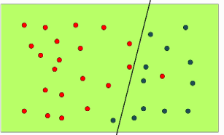
Possible Classifier
Another way
Now we got those two red points that those just keep that points are on the wrong side of the line earlier now seem to be on the right side
Left - will not buy a computer
Right, buy a computer
Performance measure is improved
But this classifier takes two parameters :age and income into consideration

Slide 47
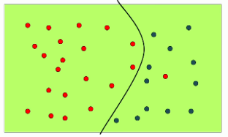
Possible Classifier
Another way
It is now a quadratic
Define three parameters .
ax²+ bx+ c,
Three parameters in order to find the quadratic

Slide 48
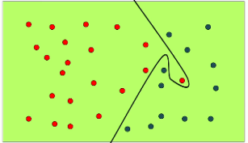
Possible Classifier
Another way
Not sure how many parameters you need
Its complex
He was sure to buy , but some issue like
There might be emergency call/situation for this customer
Not recorded the data

Slide 49
Inductive Biases
Assumption Made :
Everything to the left - will not buy the computer
Everything to the right - will buy a computer
Lines/curves are able to segregate people who buy from who do not buy
Kind of an assumption made about the distribution of the input data and the class labels.
So this kind of assumptions that we make about these lines are known as inductive biases
Language bias : the type of lines that I am going to draw
Search bias: what order am I going to examine all these possible lines.

Slide 50
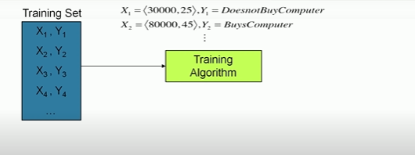
The Flow

Slide 51
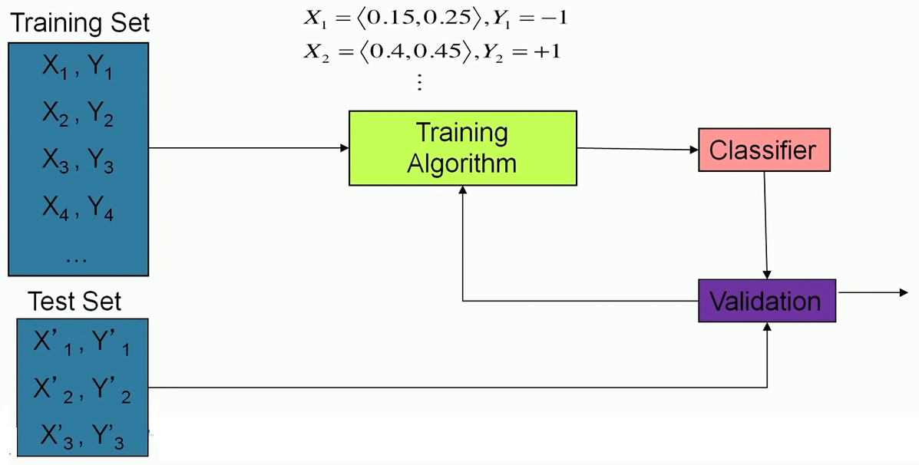
The Flow

Slide 52
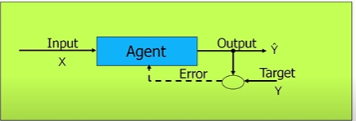
Training
Learning agent will take an input and it will produce an output Ŷ which it thinks is the correct output
But it will compare it against the actual target Y it was given for the in the training
And relearn for errors
Its an iterative process
Most of the classification algorithms or even regression algorithms operates in similar fashion

Slide 53
Few Applications
Credit card fraud detection (Valid transaction or not)
Sentiment analysis(+ve review / -ve review)
Churn prediction (a customer who is in the system is likely to leave your system or is going to continue )

Slide 54
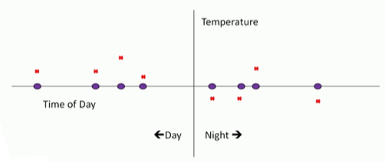
Prediction or Regression
Where the output to predict is no longer a discrete value it is not like – will buy a computer or does not buy a computer
It is more of a continuous value
Different times of day you have recorded the temperature
Input to the system- Time of day
Output from the system - Temperature that was measured at a particular point at the time
You are going to get your experience or your training data is going to take this form.
Blue points - input
Red points - the outputs that you are expected to predict
Points: Left (Day) , Right (Night)

Slide 55
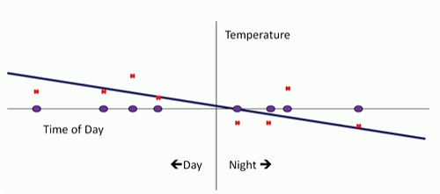
Prediction or Regression
Just like previous case of classification : simple as possible fit - draw a straight line that is as close as possible to these points
Simple solution - certain points at which we are making large errors right - try to fix that.
The Fig shows day time temperatures are more or less fine
Night times we seem to be doing something really off because we are going off too much to the right-hand side.
How if you could do something more complex
Just like in the classification case where we wanted to get that one point right so we could try and fit all these temperatures that were given to us by looking at a sufficiently complex curve.

Slide 56
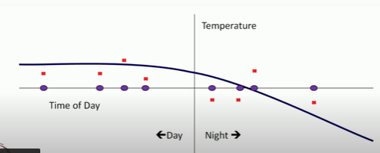
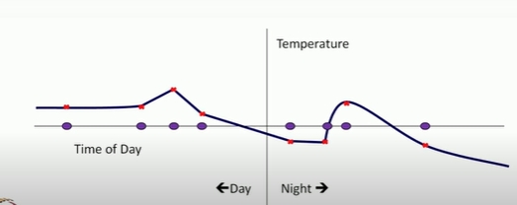
Prediction or Regression
Try and fit all these temperatures that were given to us by looking at a sufficiently complex curve.

Slide 57
Prediction or Regression
Just like in the classification case where we wanted to get that one point so we could try and fit all these temperatures that were given to us by looking at a sufficiently complex curve.
These kinds of solutions where we try to fit the noise in the data we are trying to make the solution predict the noise in the training data correctly are known as over fitting
Over fit solutions and one of the things that we look to avoid in machine learning is to over fit to the training data

Slide 58
Generate Synthetic Data with Python

Slide 59
Generate Synthetic Data with Python
A problem with machine learning, especially when you are starting out and want to learn about the algorithms, is that it is often difficult to get suitable test data.
Some cost a lot of money, others are not freely available because they are protected by copyright.
Therefore, artificially generated test data can be a solution in some cases.

Slide 60
Generate Synthetic Data with Python
On the one hand, there are small toy data sets
But it also offers larger data sets that are often used in the machine learning community to test algorithms or also serve as a benchmark.
It provides us with data coming from the 'real world'.

Slide 61
Generate Synthetic Data with Python
But in many cases this is still not sufficient.
Maybe you find the right kind of data, but you need more data of this kind or the data is not completely the kind of data you were looking for, e.g. maybe you need more complex or less complex data.
This is the point where you should consider to create the data yourself.

Slide 62
Generate Synthetic Data with Python
Here, sklearn offers help.
It includes various random sample generators that can be used to create custom-made artificial datasets.
Datasets that meet your ideas of size and complexity.

Slide 63
The Need for Synthetic Data
There are many other instances, where synthetic data may be needed.
For example, real data may be hard or expensive to acquire, or it may have too few data-points.
Another reason is privacy, where real data cannot be revealed to others

Slide 64
Few reasons why you need generated data
Can your models handle noisy labels?
What happens when 99% of your labels are negative and only 1% are positive?
if your models can tell you which features are redundant?
In case of model provided feature importances how does the model handle redundant features.
Does removing redundant features improve your model’s performance?
How does your model behave when Redundant features, noise and imbalance are all present at once in your dataset?
If you have N datapoints and M features, what are the safe values of N,M so your model doesn’t overfit?

Slide 65
Week 5

Slide 66
What is Regression Analysis?
Regression analysis is a form of predictive modelling technique which investigates the
relationship between a dependent (target) and independent variable(s) (predictor).
Predicting: This technique is used for forecasting, time series modelling and finding the causal effect relationship between the variables.
For example, relationship between rash driving and number of road accidents by a driver is best studied through regression.

Slide 67
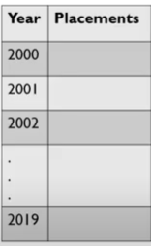
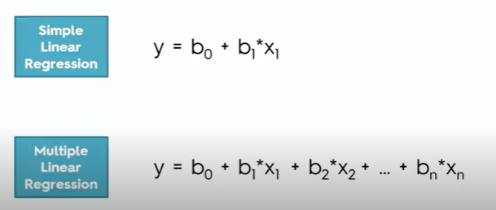
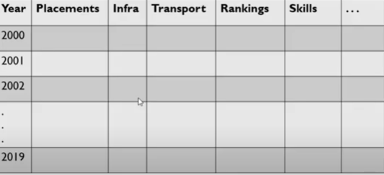
Types (x= studying, y=grade)

Slide 68
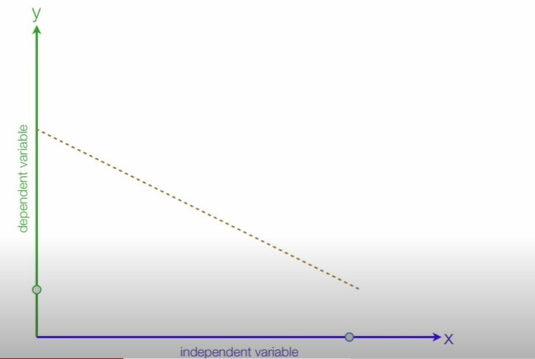
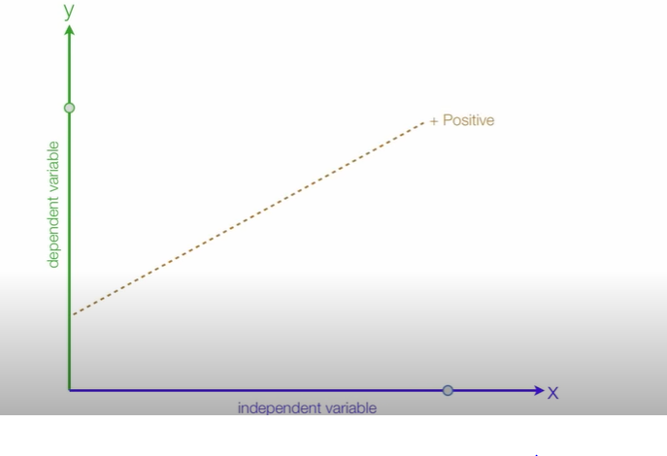
Positive Relationship (x= Studying , y=Grades) Negative Relationship (x= Instagram y= Grades)

Slide 69
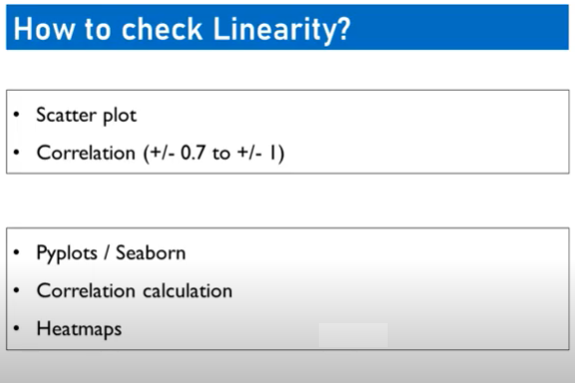
Scatter plot
Draw straight line which connects most of the data points
Correlation

Slide 70
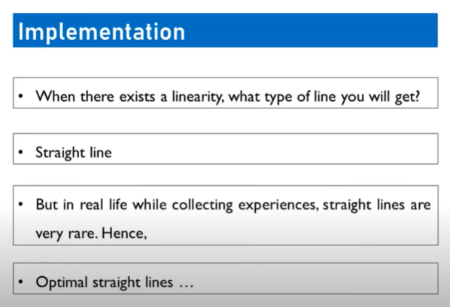

Slide 71
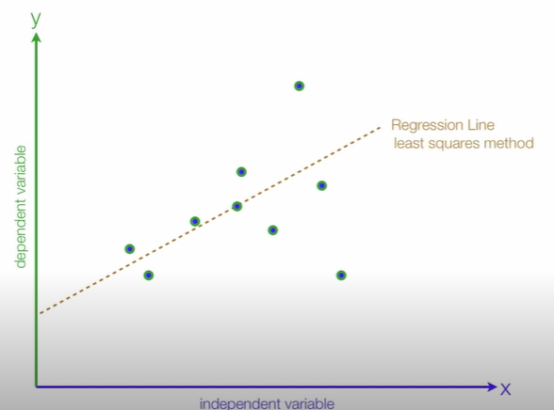
Population Regression Line

Slide 72
Population Regression Line
Regression Line
y
Estimated
Dependent Variables
Actual
Errors
x
Independent Variables

Slide 73
Population Regression Line
Example
Population regression function =
Regression Line
𝑦 = 𝑏₀+𝑏₁x
𝑦 = Estimated Grades
x = Study Time
𝑏₀= Intercept
𝑏₁= Slope
Estimated Grades
𝑏₁= Slope
𝑏₀= Intercept
Study Time

Slide 74
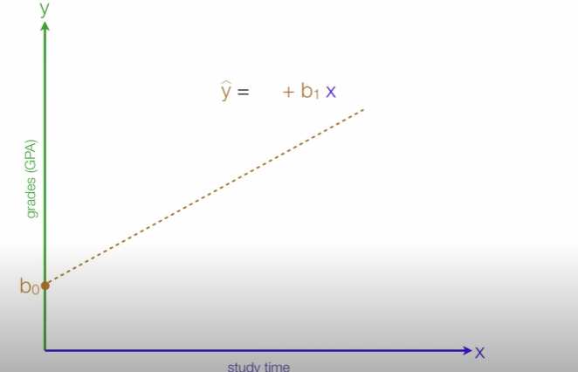
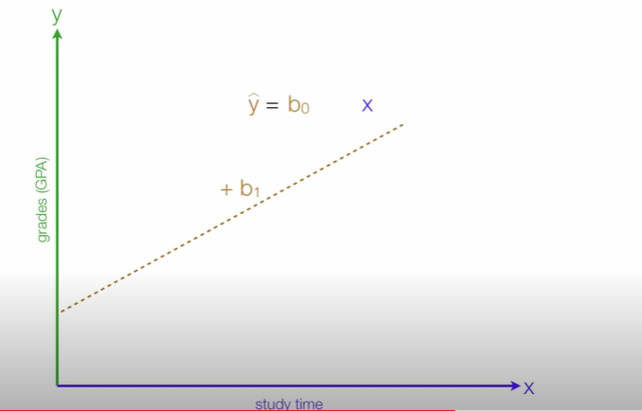
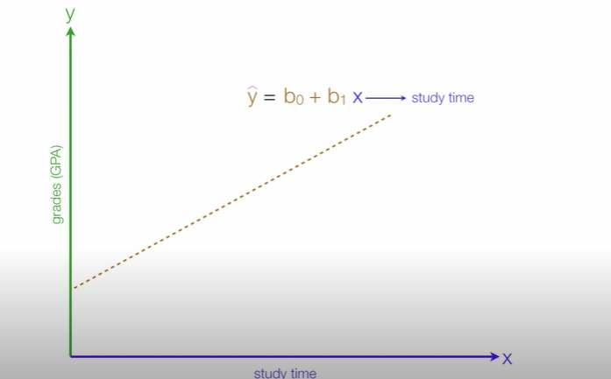
Regression

Slide 75
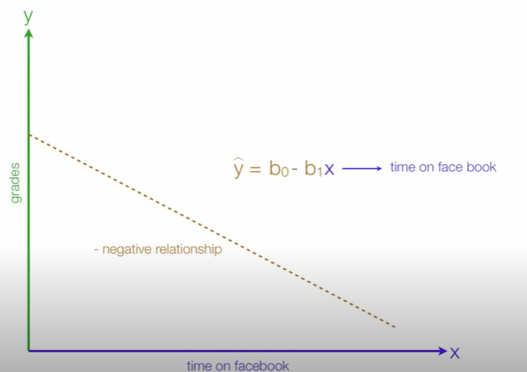
Regression

Slide 76

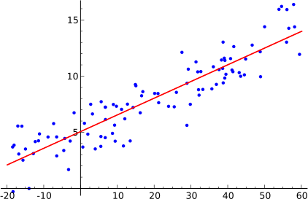
Simple Linear Regression Model
Simple linear regression model is a model with a single regressor x that has a linear relationship with a
response y.
Simple linear regression model:
Intercept
Slope
Random error component
y = 𝑏₀+𝑏₁x + ɛ
Response variable Regressor variable
In this technique, the dependent variable is continuous
and random variable, independent variable(s) can
be continuous or discrete but it is not a
random
variable, and nature of regression line is linear.

Slide 77
Least Square Estimation for Parameters
The parameters 𝑏₀ and 𝑏₁are unknown and must be estimates using sample data:
(𝑥₁,𝑦₁), (𝑥₂,𝑦₂),……(𝑥_{𝑛},𝑦_{𝑛})
𝑦 = 𝑏₀+𝑏₁x + ɛ
y
y
𝑦 = 𝑏 +𝑏 x + ɛ
𝑖 0 1 i
i
x
x

Slide 78
Calculate linear regression (using least square method)
x | y
1 | 2
2 | 4
3 | 5
4 | 6
5 | 7

Slide 79
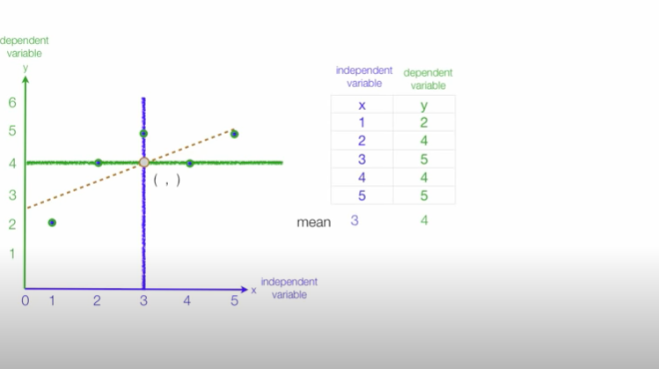
Calculate linear regression using least square method (minimize the distance between the errors)

Slide 80
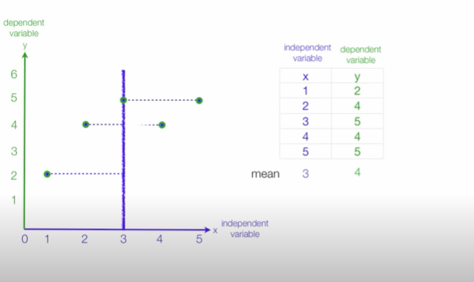
Distance from the x value to the mean for all observations

Slide 81
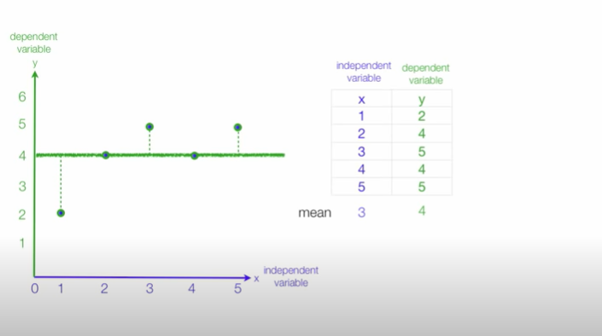
Distance from the y value to the mean for all observations

Slide 82
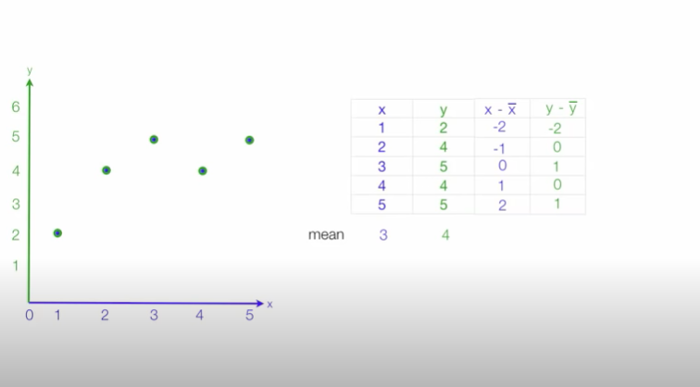
Distance from the x and y value to the mean for all observations

Slide 83
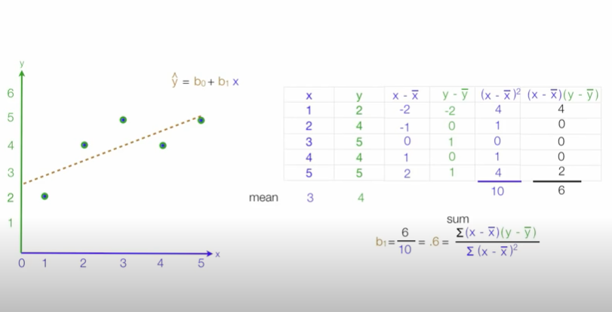
To calculate b₁

Slide 84
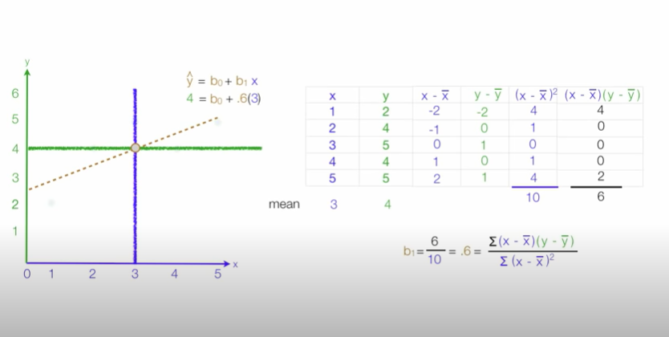
To calculate b₀

Slide 85
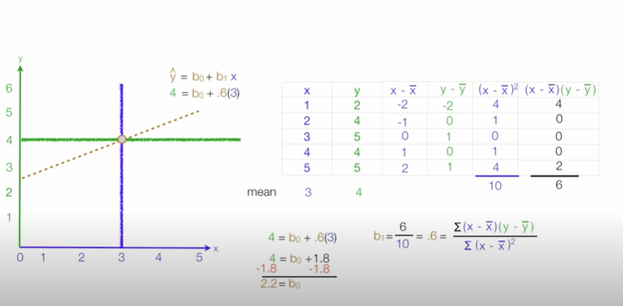
To calculate b₀

Slide 86
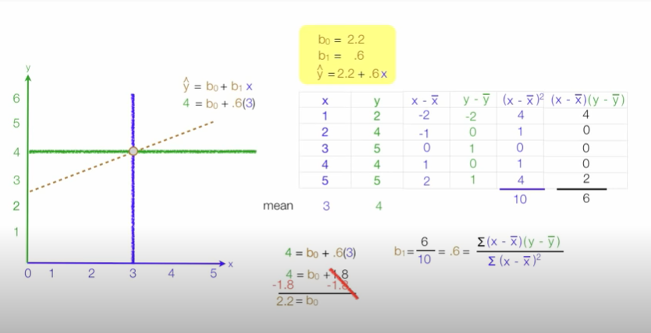
To calculate b₀

Slide 87
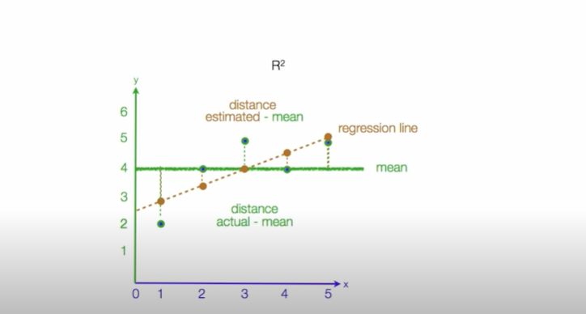
CALCULATING R SQUARED

Slide 88
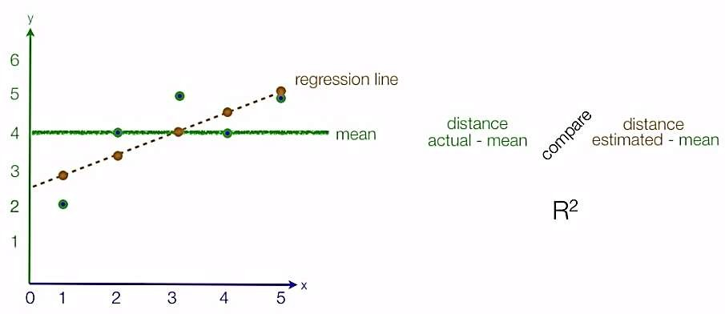
Calculating R² Using Regression Analysis
R-squared is a statistical measure of how close the data are to the fitted regression line(For measuring the
goodness of fit ). It is also known as the coefficient of determination.
Firstly we calculate distance between actual values and mean value and also calculate distance between estimated value and mean value.
Then compare both the distances.

Slide 89

R squared Predicted
y - mean

Slide 90



R squared Estimated

Slide 91


Example

Slide 92




Performance of Model

Slide 93

Standard error of the Estimate (Mean square error)
The standard error of the estimate is a measure of the accuracy of predictions.
Note: The regression line is the line that minimizes the sum of squared deviations of prediction (also called the sum of squares error).
The standard error of the estimate is closely related to this quantity and is defined below:
Where
Y = actual value Y’= Estimated Value
N = No. of observations

Slide 94

Difference between R² and Standard error of the Estimate

Slide 95


Example : Standard Error of the Estimate used in Regression Analysis (Mean Square Error)
Error: estimated distance between actual

Slide 96

Example : Standard Error of the Estimate used in Regression Analysis (Mean Square Error)
Where n is the no of observations

Slide 97

Example : Standard Error of the Estimate used in Regression Analysis (Mean Square Error)
Where n is the no of observations

Slide 98

Example : Standard Error of the Estimate used in Regression Analysis (Mean Square Error)
Where n is the no of observations

Slide 99

Example : Standard Error of the Estimate used in Regression Analysis (Mean Square Error)
Where n is the no of observations

Slide 100

Difference

Slide 101


Slide 102


Slide 103


Slide 104


Slide 105




Slide 106



Slide 107


Slide 108

Mean will change bec filled up with nan fill up with mean whose ffmc>90

Slide 109

All the missing values has been filled

Slide 110


Slide 111


Slide 112


Slide 113


Slide 114


Slide 115


Slide 116
Week 6

Slide 117
Regression
v/s Classification

Slide 118


Slide 119
Classification
●
Output type: discrete
Trying to find: a boundary
Evaluation: accuracy
Regression
Output type: continuous
Trying to find: best fit line
Evaluation: sum of sqaured errors
●

Slide 120


Slide 121



Slide 122
Logistic Regression
Is not used for regression , it is used for classification
Why the name is Logistic Regression
It uses the underlying principle of simple linear regression
Binary outcomes instead of continuous outcomes
Interested in probability of the outcome for a given value of the independent varaible

Slide 123


Slide 124


You want to build a machine learning model that can probably do prediction based on the age of the customer whether they bought the insurance or not!
So you will plot the scatter plots for the given data

Slide 125
There is a pattern
Young People – No
Old People – yes
Based on this you are building a Machine learning model based on the age of the customer

Slide 126

Linear Regression

Slide 127

Linear Regression
To the right - yes
To the right - no
OUTLAYERS
OUTLAYERS

Slide 128

Linear Regression (LR)
If there is a customer of age 80 then my linear graph will look as mentioned in below figure
Therefor LR is not a good choice if your data is categorical
Prediction Wrong

Slide 129

Linear models have a draw back of decision boundary from - $∞$ to + $∞$
We need to squeeze the linear line in to some function , In Log Reg we use sigmoid funct to squeeze the line such that values fall between 0-1
Prediction Wrong

Slide 130


Slide 131

What is the probability between age 35 – 55

Slide 132

Probability can never be between 0 or above 1

Slide 133

Imagine if you can draw a line like mentioned below
This is a much better fit compared to the linear equation
This model works better than the previous LR

Slide 134

Imagine if you can draw a line like mentioned below
How do you come up with this type of S curve line that fits the model which has categorical data

Slide 135

Using Sigmoid/Logit

Slide 136

SigmoidFunction
Odds: Chances of happening one event over chances of this event not happening
If you give a set of numbers to sigmoid function it will convert that number between 0-1 and the graph you get is S shape

Slide 137

Sigmoid Function
convert that number between 0-1 and the graph you get is S shape , Applied the sigmoid function on top of the linear equation that’s how we get S shape curve that fits better for classification problem

Slide 138


Slide 139


Slide 140
Stretching and Movement for the S curve
Stretching – handled by mx
Movement – Up and down (is handled by b which is intercept)
Advantages :
Resistant to Overfitting
Extended to multiclass problem

Slide 141

When to use logistic Regression

Slide 142
When to apply Logistic Regression
Is the dataset supervised ? (having output column?)
Is the input data numeric?
Is the input data linear?
Is the output column categorical?
Is the output column probabilistic? We should have finite no of class labels..
Yes!... you may use logistic regression
Is the dataset Linear? ways to identify linearity
Use Correlation
Plot scatter chart
may use pair plots

Slide 143


Slide 144

How to map to the class label Only yes / no between the values 0.3, .5 , .6 , .7 Instead of writing only if else statement , for smooth transition between 1 and 0 we go for sigmoid function

Slide 145


Slide 146
Precision
Precision attempts to answer the following question:
What proportion of positive identifications was actually correct?
Recall
Recall attempts to answer the following question:
What proportion of actual positives was identified correctly?

Slide 147


Slide 148


Slide 149


Slide 150


Slide 151
Week 6

Slide 152
CLASSIFICATION

Slide 153
Decision trees are a model where we break our data by making decisions using series of conditions(questions).
Introduction
Decision trees

Slide 154
Decision tree algorithm
A decision tree is a hierarchical data structure implementing the divide-and-conquer strategy.
These are also termed as CART algorithms.
These are used for
Classification and
Regression

Slide 155
Decision tree components
Root node
It refers to the start of the decision tree with maximum split ( information Gain)
Node
Node is a condition with multiple outcomes in the tree.
Leaf
This is the final decision(end point) of a node from the condition(question)

Slide 156


Slide 157

Basic Concept
A Decision Tree is an important data structure known to solve many computational problems
Example :Binary Decision Tree

Slide 158

Basic Concept
In previous Example, we have considered a decsion tree where values of any attribute if binary only. Decision tree is also possible where attributes are of continuous data type
Example Decision Tree with numeric data

Slide 159

Some Characteristics
Decision tree may be n-ary, n ≥ 2.
There is a special node called root node.
All nodes drawn with circle (ellipse) are called internal nodes.
All nodes drawn with rectangle boxes are called terminal nodes or leaf nodes.
Edges of a node represent the outcome for a value of the node.
In a path, a node with same label is never repeated.
Decision tree is not unique, as different ordering of internal nodes can give different decision tree.

Slide 160
Decision Tree and Classification Task
Decision tree helps us to classify data.
Internal nodes are some attribute
Edges are the values of attributes
External nodes are the outcome of classification
Such a classification is, in fact, made by posing
questions starting from the root node to each
terminal node.

Slide 161
Entropy is the degree of uncertainty, impurity or disorder of a random variable, or a measure of purity. It characterizes the impurity of an arbitrary class of examples.
Information gain computes the difference between entropy before and after split and specifies the impurity in class elements.
The gini index, or gini coefficient, or gini impurity computes the degree of probability of a specific variable that is wrongly being classified when chosen randomly and a variation of gini coefficient. It works on categorical variables, provides outcomes either be “successful” or “failure” and hence conducts binary splitting only

Slide 162

Definition of Decision Tree
Given a database D = $\left\{t_{1},t_{2},…..,t_{n}\right\}, w$here $t_{i}$ denotes a tuple, which is defined by a set of attribute $A=\left\{A_{1},A_{2},…..,A_{m}\right\}. Also, given a$set of classes C = $\left\{c_{1},c_{2},…..,c_{k}\right\}$.
A decision tree T is a tree associated with D that has the following properties:
Each internal node is labeled with an attribute A_{i}
Each edges is labeled with predicate that can be applied to the attribute associated with the parent node of it
Each leaf node is labeled with class c_{j}
Definition: Decision Tree

Slide 163

Definition of Entropy
Suppose there are m distinct objects, which we want to identify by asking a series of Yes/No questions. Further, we assume that m is an exact power of 2, say $m=2^{n}$, where $n≥1$.
Definition : Entropy
The entropy of a set of m distinct values is the minimum number of yes/no questions needed to determine an unknown values from these m possibilities.

Slide 164
ID3: Decision Tree Induction Algorithms
Quinlan [1986] introduced the ID3, a popular short form of Iterative Dichotomizer 3 for decision trees from a set of training data.
In ID3, each node corresponds to a splitting attribute and each arc is a possible value of that attribute.
At each node, the splitting attribute is selected to be the most informative among the attributes not yet considered in the path starting from the root.

Slide 165
Algorithm ID3
In ID3, entropy is used to measure how informative a node is.
It is observed that splitting on any attribute has the property that average entropy of the resulting training subsets will be less than or equal to that of the previous training set.
ID3 algorithm defines a measurement of a splitting called Information Gain to determine the goodness of a split.
The attribute with the largest value of information gain is chosen as the splitting attribute and
it partitions into a number of smaller training sets based on the distinct values of attribute under split.

Slide 166

Defining Information Gain
We consider the following symbols and terminologies to define information gain, which is denoted as α.
D $≡$ denotes the training set at any instant
|D| $≡$ denotes the size of the training set D
E(D) $≡$ denotes the entropy of the training set D
The entropy of the training set D
E(D) = -$\sum_{i=1}^{k}{p_{i}}\log_{2}(p_{i}$
where the training set D has $c_{1}$, $c_{2}$, … , $c_{k}$, the k number of distinct classes and
$p_{i}$, 0<${ p}_{i}≤1$ is the probability that an arbitrary tuple in D belongs to class $c_{i}$ (i = 1, 2, … , k).

Slide 167

Defining Information Gain
p_{i} can be calculated as
$p_{i}$ = $\frac{{|C}_{i,D}|}{|D|}$
where $C_{i,D}$ is the set of tuples of class ${ c}_{i}$ in D.
Suppose, we want to partition D on some attribute A having m distinct values {$a_{1},a_{2}, …,a_{m}\}.$
$Attribute A can be considered$to split D into m partitions {$D_{1},D_{2}, …,D_{m}$}, where $D_{j}$ (j = 1,2, … ,m) contains those tuples in D that have outcome $a_{j}$ of A.

Slide 168

Defining Information Gain
Definition Weighted Entropy
The weighted entropy denoted as 𝐸_{𝐴}(𝐷) for all partitions of D with respect to A is given by:
$E_{A}(D)$ =$\sum_{j=1}^{m}{\frac{{|D}_{j}|}{|D|}}$ E($D_{j}$)
Here, the term $\frac{{|D}_{j}|}{|D|}$ denotes the weight of the j-th training set.
More meaningfully, 𝐸_{𝐴}(𝐷) is the expected information required to classify a tuple from D based on the splitting of A.

Slide 169


Defining Information Gain
Our objective is to take A on splitting to produce an exact classification (also called pure), that is, all tuples belong to one class.
However, it is quite likely that the partitions is impure, that is, they contain tuples from two or more classes.
In that sense, $E_{A}(D)$ is a measure of impurities (or purity). A lesser value of $E_{A}(D)$ implying more power the partitions are.
Information gain, $α\left(A,D\right)$ of the training set D splitting on the attribute A is given by
$α\left(A,D\right)$ = E(D) - $E_{A}(D)$
In other words, $α\left(A,D\right)$ gives us an estimation how much would be gained by splitting on A. The attribute A with the highest value of $α$ should be chosen as the splitting attribute for D.
Definition : Information Gain

Slide 170


Information Gain ( IG )
Every node yields maximum data in each split which could be achieved by IG

Slide 171



Impurity Metrics
It can be calculated by using impurity measures of each split
1. Gini Index (I_{g})
2. Entropy ( I_{h} )
3. Classification error ( I_{e} )

Slide 172
Applications :
Business Management
Customer Relationship Management
Fraudulent Statement Detection
Engineering
Energy Consumption
Fault Diagnosis
Healthcare Management

Slide 173
Example Decision tree using ID3 Algorithm

Slide 174
Example Decision tree using ID3 Algorithm

Slide 175
Training Examples
Day
Outlook
Temp.
Humidity
Wind
Play Tennis
D1
Sunny
Hot
High
Weak
No
D2
Sunny
Hot
High
Strong
No
D3
Overcast
Hot
High
Weak
Yes
D4
Rain
Mild
High
Weak
Yes
D5
Rain
Cool
Normal
Weak
Yes
D6
Rain
Cool
Normal
Strong
No
D7
Overcast
Cool
Normal
Weak
Yes
D8
Sunny
Mild
High
Weak
No
D9
Sunny
Cold
Normal
Weak
Yes
D10
Rain
Mild
Normal
Strong
Yes
D11
Sunny
Mild
Normal
Strong
Yes
D12
Overcast
Mild
High
Strong
Yes
D13
Overcast
Hot
Normal
Weak
Yes
D14
Rain
Mild
High
Strong
No

Slide 176
Which attribute gives max information out of available attributes
4 attribute – calculate the information gain of every attribute
Attribute with max information gain will be considered as root node
Then start building the DT
Calculate the information gain of every attribute
Day
Outlook
Temp.
Humidity
Wind
Play Tennis
D1
Sunny
Hot
High
Weak
No
D2
Sunny
Hot
High
Strong
No
D3
Overcast
Hot
High
Weak
Yes
D4
Rain
Mild
High
Weak
Yes
D5
Rain
Cool
Normal
Weak
Yes
D6
Rain
Cool
Normal
Strong
No
D7
Overcast
Cool
Normal
Weak
Yes
D8
Sunny
Mild
High
Weak
No
D9
Sunny
Cold
Normal
Weak
Yes
D10
Rain
Mild
Normal
Strong
Yes
D11
Sunny
Mild
Normal
Strong
Yes
D12
Overcast
Mild
High
Strong
Yes
D13
Overcast
Hot
Normal
Weak
Yes
D14
Rain
Mild
High
Strong
No

Slide 177



Slide 178

Day
Outlook
Temp.
Humidity
Wind
Play Tennis
D1
Sunny
Hot
High
Weak
No
D2
Sunny
Hot
High
Strong
No
D3
Overcast
Hot
High
Weak
Yes
D4
Rain
Mild
High
Weak
Yes
D5
Rain
Cool
Normal
Weak
Yes
If there are only positive / only negative example entropy is 0
If we have equal no of positive and equal no negative we have entropy 1
D6
Rain
Cool
Normal
Strong
No
D7
Overcast
Cool
Normal
Weak
Yes
D8
Sunny
Mild
High
Weak
No
D9
Sunny
Cold
Normal
Weak
Yes
D10
Rain
Mild
Normal
Strong
Yes
D11
Sunny
Mild
Normal
Strong
Yes
D12
Overcast
Mild
High
Strong
Yes
D13
Overcast
Hot
Normal
Weak
Yes
D14
Rain
Mild
High
Strong
No

Slide 179

Calculate Gain for the attribute outlook

Slide 180



Slide 181


Slide 182


Slide 183


Slide 184

Attribute Outlook has the maximum information gain

Slide 185
Outlook is the root node
Sunny --- d1 d2 d8 d9 d11
Overcast ----- d3 d7 d12 d13
Rain ------ d4 d5 d6 d10 d14
These are the examples we need to consider

Slide 186


Slide 187

WRT SUNNY

Slide 188


Slide 189


Slide 190


Slide 191


Slide 192

WRT RAIN

Slide 193


Slide 194


Slide 195



Slide 196


Slide 197
Top-Down Induction of Decision Trees ID3
A ← the “best” decision attribute for next node
Assign A as decision attribute for node
For each value of A create new descendant
Sort training examples to leaf node according to
the attribute value of the branch
If all training examples are perfectly classified (same value of target attribute) stop, else iterate over new leaf nodes.

Slide 198
GINI INDEX

Slide 199


Slide 200


Slide 201


Slide 202


Slide 203
For each attribute find all the gini index
Then select the minimum gini index for that particular attribute
Now do that for all attributes
Then find out minimum gini index from all the attributes

Slide 204
NAIVE BAYES CLASSIFIER

Slide 205
Naïve Bayes Classifier Algorithm
Naïve Bayes algorithm is a supervised learning algorithm, which is based on Bayes theorem and used for solving classification problems.
It is mainly used in text classification that includes a high-dimensional training dataset.
Naïve Bayes Classifier is one of the simple and most effective Classification algorithms which helps in building the fast machine learning models that can make quick predictions.
It is a probabilistic classifier, which means it predicts on the basis of the probability of an object.
Some popular examples of Naïve Bayes Algorithm are spam filtration, Sentimental analysis, and classifying articles.

Slide 206
Why is it called Naïve Bayes?
It comprises of two words Naïve and Bayes
Naive: it assumes that the occurrence of a certain feature is independent of the occurrence of other features.
Such as if the fruit is identified on the bases of color, shape, and taste, then red, spherical, and sweet fruit is recognized as an apple.
Hence each feature individually contributes to identify that it is an apple without depending on each other.
Bayes: It is called Bayes because it depends on the principle of Bayes' Theorem.

Slide 207

Bayes' Theorem
Bayes' theorem is also known as Bayes' Rule or Bayes' law, which is used to determine the probability of a hypothesis with prior knowledge.
It depends on the conditional probability.
Where,
P(A|B) is Posterior probability: Probability of hypothesis A on the observed event B.
P(B|A) is Likelihood probability: Probability of the evidence given that the probability of a hypothesis is true.
P(A) is Prior Probability: Probability of hypothesis before observing the evidence.
P(B) is Marginal Probability: Probability of Evidence.

Slide 208



Slide 209


Slide 210
If we want to classify any new instance either into yes/no
1. Calculate the Prioir probability
2. Calculate the current probabilities

Slide 211

Prioir probability – Prob of YES and prob of No

Slide 212

Current Prob

Slide 213

NAIVE BAYES CLASSIFIER EQUATION

Slide 214
Week 7
WITHOUT USING PACAKAGES
DECISION TREE AND LINEAR REGRESSION

Slide 215
Week 8
PERCEPTRON

Slide 216
Perceptron

Slide 217
The story ahead ...
What about non-boolean (say, real) inputs ?
20

Slide 218
The story ahead ...
What about non-boolean (say, real) inputs ?
Do we always need to hand code the threshold ?
20

Slide 219
The story ahead ...
What about non-boolean (say, real) inputs ?
Do we always need to hand code the threshold ?
Are all inputs equal ? What if we want to assign more weight (importance) to some inputs ?
20

Slide 220
The story ahead ...
What about non-boolean (say, real) inputs ?
Do we always need to hand code the threshold ?
Are all inputs equal ? What if we want to assign more weight (importance) to some inputs ?
What about functions which are not linearly separable ?
20

Slide 221
Frank Rosenblatt, an American psychologist, pro- posed the classical perceptron model (1958)
21

Slide 222
y
Frank Rosenblatt, an American psychologist, pro- posed the classical perceptron model (1958)
w₁
w₂
.. ..
w_{n}
x₁ x₂
..
..
x_{n}
21

Slide 223
y
Frank Rosenblatt, an American psychologist, pro- posed the classical perceptron model (1958)
A more general computational model than McCul- loch–Pitts neurons
w₁
w₂
.. ..
w_{n}
x₁ x₂
..
..
x_{n}
21

Slide 224
y
Frank Rosenblatt, an American psychologist, pro- posed the classical perceptron model (1958)
A more general computational model than McCul- loch–Pitts neurons
Main differences: Introduction of numerical weights for inputs and a mechanism for learning these weights
w₁
w₂
.. ..
w_{n}
x₁ x₂
..
..
x_{n}
21

Slide 225
y
Frank Rosenblatt, an American psychologist, pro- posed the classical perceptron model (1958)
A more general computational model than McCul- loch–Pitts neurons
Main differences: Introduction of numerical weights for inputs and a mechanism for learning these weights
Inputs are no longer limited to boolean values
w₁
w₂
.. ..
w_{n}
x₁ x₂
..
..
x_{n}
21

Slide 226
y
Frank Rosenblatt, an American psychologist, pro- posed the classical perceptron model (1958)
A more general computational model than McCul- loch–Pitts neurons
Main differences: Introduction of numerical weights for inputs and a mechanism for learning these weights
Inputs are no longer limited to boolean values
Refined and carefully analyzed by Minsky and Pa- pert (1969) - their model is referred to as the per- ceptron model here
w₁
w₂
.. ..
w_{n}
x₁ x₂
..
..
x_{n}
21

Slide 227


Slide 228


Slide 229


Slide 230
We will now try to answer the following questions:
Why are we trying to implement boolean functions?
Why do we need weights ?
Why is w₀ = −θ called the bias ?

Slide 231
y
Consider the task of predicting whether we would like a movie or not
w₀ = −θ
x₀ = 1
w₁
w₂ w₃
x₁
x₂
x₃
24

Slide 232
y
Consider the task of predicting whether we would like a movie or not
Suppose, we base our decision on 3 inputs (binary, for sim- plicity)
w₀ = −θ
x₀ = 1
w₁
w₂ w₃
x₁
x₂
x₃
24

Slide 233
y
Consider the task of predicting whether we would like a movie or not
Suppose, we base our decision on 3 inputs (binary, for sim- plicity)
Based on our past viewing experience (data), we may give a high weight to isDirectorNolan as compared to the other inputs
w₀ = −θ
x₀ = 1
w₁
w₂ w₃
x₁
x₂
x₃
x₁ = isActorDamon x₂ = isGenreThriller x₃ = isDirectorNolan
24

Slide 234
y
Consider the task of predicting whether we would like a movie or not
Suppose, we base our decision on 3 inputs (binary, for sim- plicity)
Based on our past viewing experience (data), we may give a high weight to isDirectorNolan as compared to the other inputs
Specifically, even if the actor is not Matt Damon and the genre is not thriller we would still want to cross the threshold θ by assigning a high weight to isDirectorNolan
w₀ = −θ
x₀ = 1
w₁
w₂ w₃
x₁
x₂
x₃
x₁ = isActorDamon x₂ = isGenreThriller x₃ = isDirectorNolan
24

Slide 235
y
w₀ is called the bias as it represents the prior (prejudice)
w₀ = −θ
x₀ = 1
w₁
w₂ w₃
x₁
x₂
x₃
x₁ = isActorDamon x₂ = isGenreThriller x₃ = isDirectorNolan
24

Slide 236
w₀ is called the bias as it represents the prior (prejudice)
A movie buff may have a very low threshold and may watch any movie irrespective of the genre, actor, director [θ = 0]
y
w₀ = −θ
x₀ = 1
w₁
w₂ w₃
x₁
x₂
x₃
x₁ = isActorDamon x₂ = isGenreThriller x₃ = isDirectorNolan
24

Slide 237
w₀ is called the bias as it represents the prior (prejudice)
A movie buff may have a very low threshold and may watch any movie irrespective of the genre, actor, director [θ = 0]
On the other hand, a selective viewer may only watch thrillers starring Matt Damon and directed by Nolan [θ = 3]
y
w₀ = −θ
x₀ = 1
w₁
w₂ w₃
x₁
x₂
x₃
x₁ = isActorDamon x₂ = isGenreThriller x₃ = isDirectorNolan
24

Slide 238
w₀ is called the bias as it represents the prior (prejudice)
A movie buff may have a very low threshold and may watch any movie irrespective of the genre, actor, director [θ = 0]
On the other hand, a selective viewer may only watch thrillers starring Matt Damon and directed by Nolan [θ = 3]
The weights (w₁, w₂, ..., w_{n}) and the bias (w₀) will depend on the data (viewer history in this case)
y
w₀ = −θ
x₀ = 1
w₁
w₂ w₃
x₁
x₂
x₃
x₁ = isActorDamon x₂ = isGenreThriller x₃ = isDirectorNolan
24

Slide 239
What kind of functions can be implemented using the perceptron? Any difference from McCulloch Pitts neurons?

Slide 240


Slide 241


Slide 242

Single Layer Perceptron
A single layer perceptron (SLP) is a feed-forward network based on a threshold transfer function. SLP is the simplest type of artificial neural networks and can only classify linearly separable cases with a binary target (1 , 0).

Slide 243

Single Layer Perceptron

Slide 244
Single Layer Perceptron
On the left side you have neurons (small circles) of x with subscripts 1, 2, … , m carrying data input.
We multiply each of the input by a weight w, also labeled with subscripts 1, 2, …, m, along the arrow (also called a synapse) to the big circle in the middle. So w1 * x1, w2 * x2, w3 * x3 and so on.
Once all the inputs are multiplied by a weight, we sum all of them up and add another pre-determined number called bias.
Then, we push the result further to the right. Now, we have this step function in the rectangle. What it means is that if the result from step 3 is any number equal or larger than 0, then we get 1 as output, otherwise if the result is smaller than 0, we get0 as output.
The output is either 1 or 0.
Note that alternatively, if you move bias to the right side of the equation in the activation function like sum(wx) ≥ -b then this -b is called a threshold value. So if the sum of the inputs and weights is greater than or equal to the threshold, then the activation triggers an 1. Otherwise, the activation outcome is 0. Choose whichever that helps you to understand better as these two ways of representation are interchangeable.

Slide 245

Single Layer Perceptron

Slide 246

Single Layer Perceptron
The single layer perceptron does not have a priori knowledge, so the initial weights are assigned randomly. SLP sums all the weighted inputs and if the sum is above the threshold (some predetermined value), SLP is said to be activated (output=1).

Slide 247

PERCEPTRON

Slide 248


PERCEPTRON

Slide 249


Slide 250

https://www.mathsisfun.com/equation_of_line.html

Slide 251

Linear and Non Linear Separability

Slide 252
Linear Separability
0
1
1
1
0
1
0
0
0
1
0
1
AND OR XOR

Slide 253
The perceptron learning rule
Idea: To mimic how a single neuron in the brain works: it either fires or it doesn't.
Steps:
1. Initialize the weights to 0 or small random numbers.
2. For each training sample x(i) :
a. Compute the output value ˆy.
b. Update the weights.

Slide 254


The perceptron learning rule
weight vector w can be more formally written as:
is the learning rate (typically a constant between 0.0 and 1.0)
y(i) is the true class label of the i^{th} training sample
yˆ(i) is the predicted class label.

Slide 255


Slide 256

Example
First pass is as follows
Input | Weight | Desired | Actual | Update? | New weight
(1, 1, 1) | (1, 0, 0) | 1 | 1 | No | (1, 0, 0)
(1, 1, -1) | (1, 0, 0) | 1 | 1 | No | (1, 0, 0)
(1,0, -1) | (1, 0, 0) | 1 | 1 | No | (1, 0, 0)
(1,-1, -1) | (1, 0, 0) | 0 | 1 | Yes | (0, 1, 1)
(1,-1, 1) | (0, 1, 1) | 0 | 0 | No | (0, 1, 1)
(1, 0, 1) | (0, 1, 1) | 0 | 1 | Yes | (-1, 1, 0)

Slide 257

Example
(Second pass):
Input | Weight | Desired | Actual | Update? | New weight
(1, 1, 1) | (-1, 1, 0) | 1 | 0 | Yes | (0, 2, 1)
(1, 1, -1) | (0, 2, 1) | 1 | 1 | No | (0, 2, 1)
(1,0, -1) | (0, 2, 1) | 1 | 0 | Yes | (1, 2, 0)
(1,-1, -1) | (1, 2, 0) | 0 | 0 | No | (1, 2, 0)
(1,-1, 1) | (1, 2, 0) | 0 | 0 | No | (1, 2, 0)
(1, 0, 1) | (1, 2, 0) | 0 | 1 | Yes | (0, 2, -1)

Slide 258

Example
Input | Weight | Desired | Actual | Update? | New weight
(1, 1, 1) | (0, 2, -1) | 1 | 1 | No | (0, 2, -1)
(1, 1, -1) | (0, 2, -1) | 1 | 1 | No | (0, 2, -1)
(1,0, -1) | (0, 2, -1) | 1 | 1 | No | (0, 2, -1)
(1,-1, -1) | (0, 2, -1) | 0 | 0 | No | (0, 2, -1)
(1,-1, 1) | (0, 2, -1) | 0 | 0 | No | (0, 2, -1)
(1, 0, 1) | (0, 2, -1) | 0 | 0 | No | (0, 2, -1)
At epoch 3 no weight changes.
⇒ stop execution of algorithm. Final weight vector: (0, 2, -1).
⇒ decision hyperplane is 2x₁ - x₂ = 0.

Slide 259





Example: final results
x₂
-
- ¹
+
Decision boundary:
C₂
2x₁ - x₂ = 0
-1
1/2
1
2
x₁
w
-
+
-1
+
C₁

Slide 260

Some Unhappiness About Perceptron Training
The perceptron learning rule fails to converge if examples are not linearly separable
▫ Can only model linearly separable classes, like (those described by) the following Boolean functions:
 AND, OR, but not XOR
When a perceptron gives the right answer, no learning takes place.
Anything below the threshold is interpreted as “no”, even if it is just below the threshold.
▫ Might be better to train the neuron based on how far
below the threshold it is?

Slide 261

Sequence

Slide 262

Iterations

Slide 263
How many Epochs
Run epochs by adjusting the weights to get the desired/best output

Slide 264
When to stop
Reached required accuracy score
Reached maximum iterations
Metrics
Accuracy
F1 score

